Slide 1
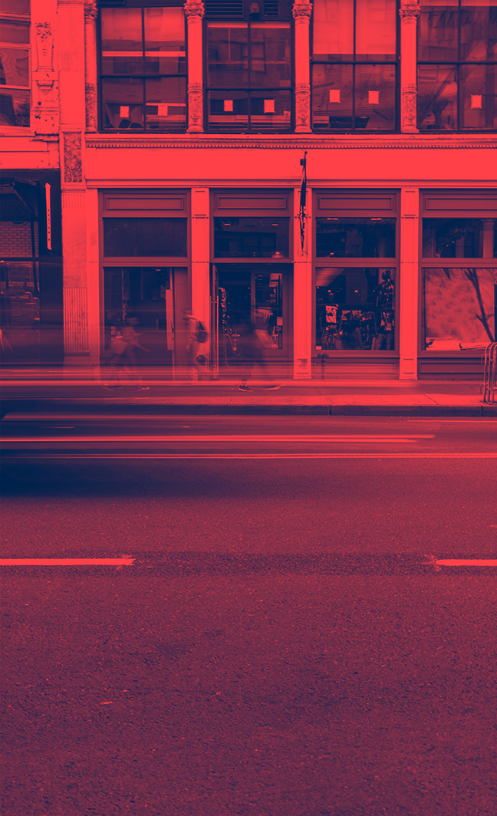
Behavior Changes During COVID-19
Whilmina Dsouza & Neviya Prakash

Slide 2
Overview
Organization Name - UMD National Center for Smart Growth (NCSG)
Goal - To analyze the impacts of the current situation on transportation needs, and physical and mental health
Purpose - To better plan and manage future situations
Data - Survey data, external data from data.gov, cdc.gov, census.gov

Slide 3
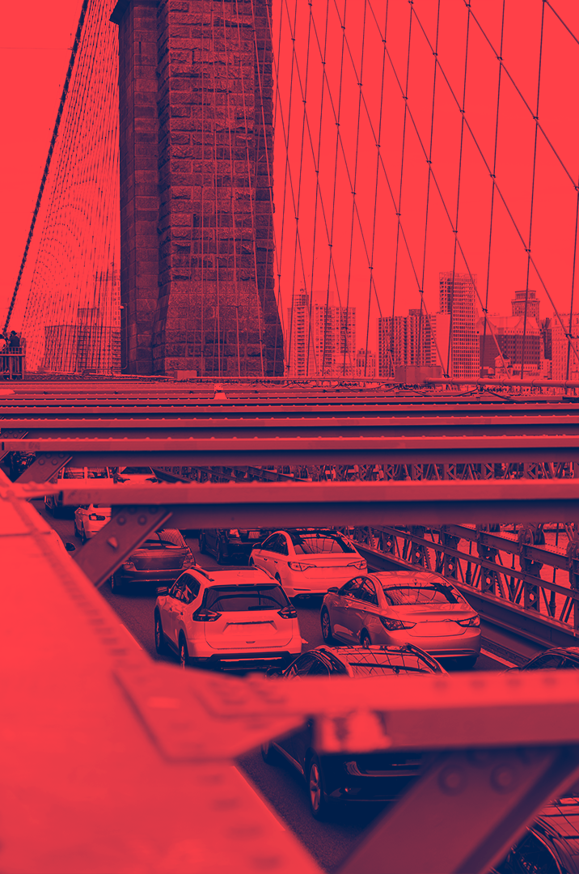
01
socio-demographic characteristics
&
behavioral changes

Slide 4
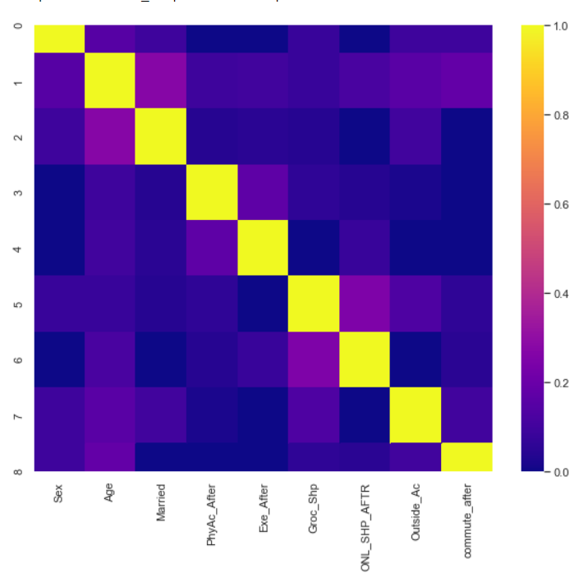
Finding relationship
Conducted hypothesis Chi-square testing to find correlation between socio-demographic characteristics and behavioral changes after Covid
Null Hypothesis - There is no relationship
Alternate Hypothesis - There is relationship
P value threshold - 0.05

Slide 5
Hypothesis testing result
P value score
Variable NAME | Physical Activity | Grocery shopping | Outdoor activity | commute
Sex | No Relation | 0.034 | 0.0099 | 0.021
Age | 0.0054 | No Relation | No Relation | 0.0075
Marital Status | No Relation | No Relation | 0.0031 | No Relation

Slide 6
02
Influence of residence and urban forms on travel

Slide 7
03
INFLUENCE OF ANXIETY AND DEPRESSION ON COVID BEHAVIORAL CHANGES

Slide 8
Tableau Visualization
Click Here to View the Viz

Slide 9
Analysis Results
Sex, age and marital status are correlated to post covid activities like physical activities, grocery shopping, outdoor activities and commute
Upto 13% experienced increased workload
Age groups 25-40, 40-60 and 60+ were involved in physical activities more than 5 times a week
Use of public transport was not seen after lockdown
Use of automobiles also drastically reduced after lockdown
Most respondents were from the urban areas in the east coast
Most anxiety and depression cases were seen in the east and the west coast

Slide 10

THANKS!
Do you have any questions?

